Slide 1
Pizza Sales Analysis Using SQL
To analyze pizza sales data stored in a relational database using SQL queries to gain insights into customer preferences, popular toppings, sales trends, and performance metrics.

Slide 2
Hello !
My name is Saurabh Dwivedi and this project
utilize SQL queries and analyze pizza sales data
stored in a relational database using SQL queries
to solve question that is related to Pizza sales

Slide 3
CONTENTS
01 Total number of orders placed
02 Total revenue from pizza sales
03 Highest-priced pizza.
04 Most common pizza size ordered
05 5 most ordered pizza types with quantities
06 Total quantity of each pizza category ordered
07 Orders by hour of the day
08 Category-wise distribution of pizzas
09 Orders by date and calculate average number of pizzas ordered per day
Top 3 most ordered pizza types based on revenue
The percentage contribution of each pizza type to total revenue
The cumulative revenue generated over time
Top 3 most ordered pizza types based on revenue for each pizza category

Slide 4


Retrieve the total number of orders placed.

Slide 5
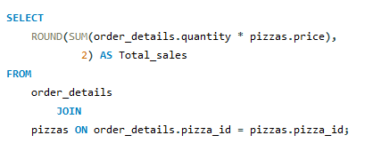

Calculate the total revenue generated from pizza sales.

Slide 6
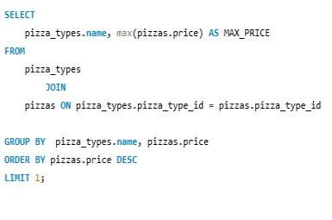

Identify the highest
priced pizza.
01

Slide 7
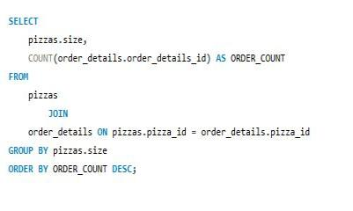
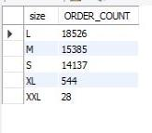
Identify the most common pizza size ordered.

Slide 8
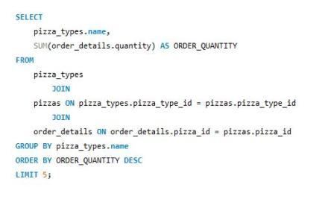
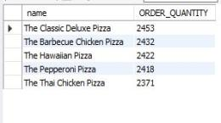
List the top 5 most ordered pizza types along with their quantities.

Slide 9
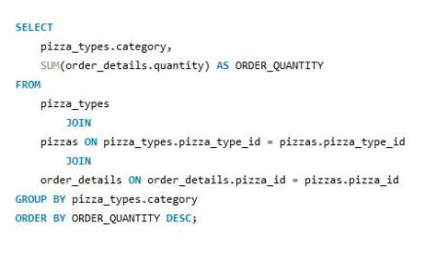
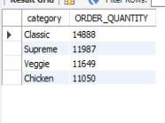
Join the necessary tables to find the total quantity of each pizza
category ordered.

Slide 10
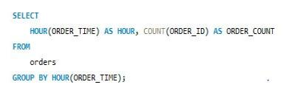
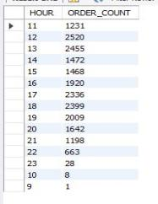
Determine the distribution
of orders by hour of the day.

Slide 11

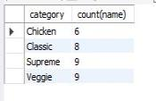
Join relevant tables to
find the category-wise
distribution of pizzas.

Slide 12
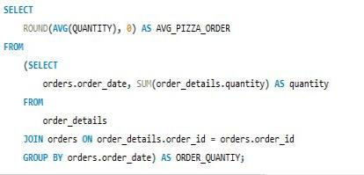

Group the orders by date
and calculate the average
number of pizzas ordered per day.

Slide 13
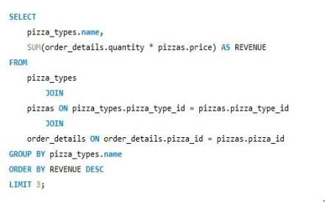
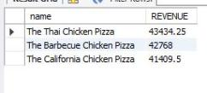
Determine the top 3 most ordered
pizza types based on revenue.

Slide 14
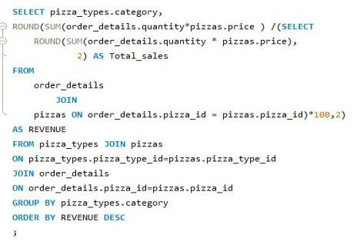
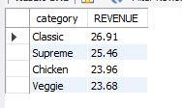
Calculate the percentage contribution of each pizza
type to total revenue.

Slide 15
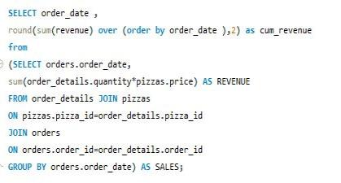
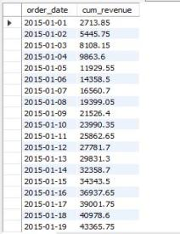
Analyze the cumulative
revenue generated over time.

Slide 16
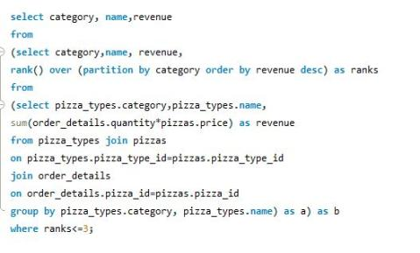
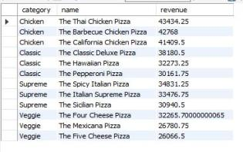
Determine the top 3 most
ordered pizza types based on
revenue for each pizza category.

Slide 17
THANK YOU

